Slide 1

Needle-like Triangles,
Matrices, and Lewis Carroll
Alan Edelman
Mathematics
Computer Science & AI Labs
Gilbert Strang
Mathematics
Computer Science & AI Laboratories

Slide 2
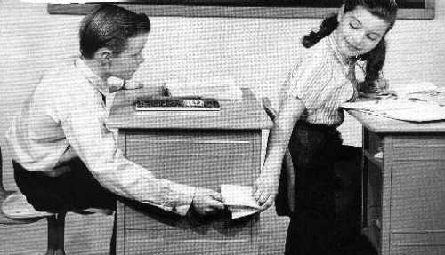
A note passed during a lecture
Can you do this integral in R⁶ ? It will tell us the probability a random triangle is acute!

Slide 3
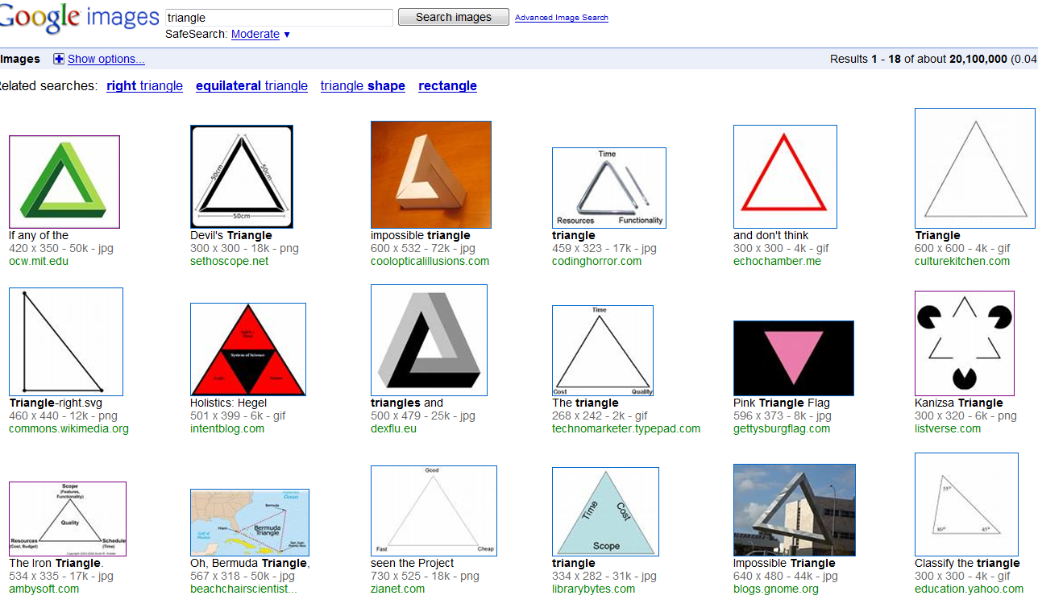
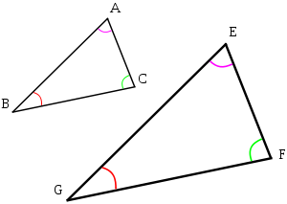
What do triangles look like?
Popular triangles as measured by Google are all acute
Textbook “any old” triangles are always acute

Slide 4
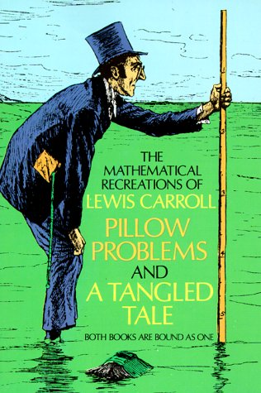
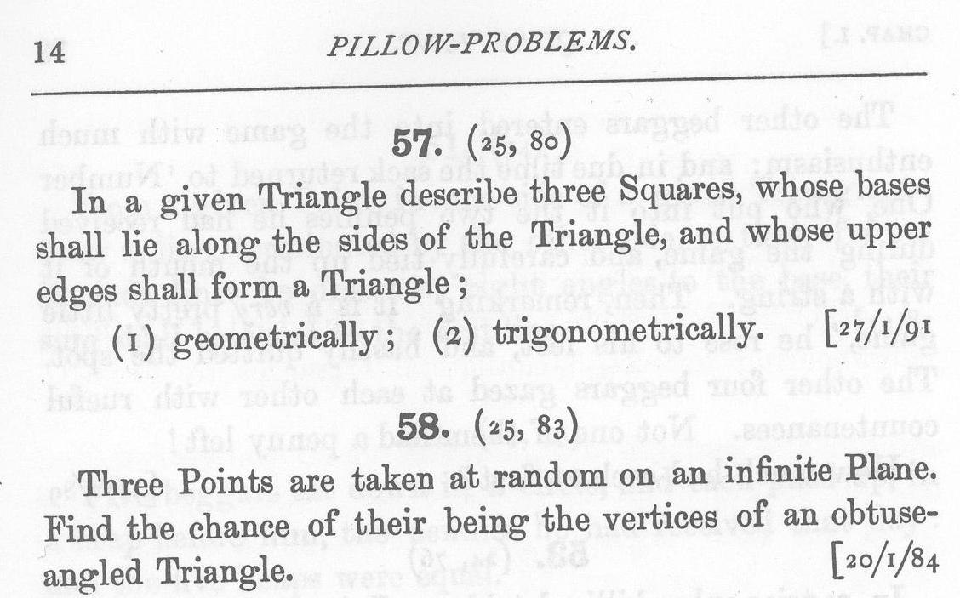
What is the probability that a random triangle is acute?
January 20, 1884

Slide 5
Depends on your definition of random: One easy case!
Uniform (with respect to area) on the space
(Angle 1)+(Angle 2)+(Angle 3)=180º
Prob(Acute)=¼

Slide 6
Random Triangles with coordinates from the Normal Distribution

Slide 7
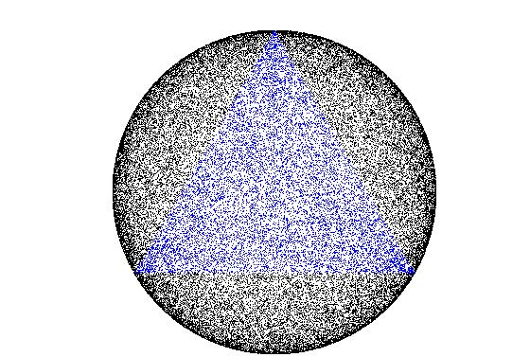
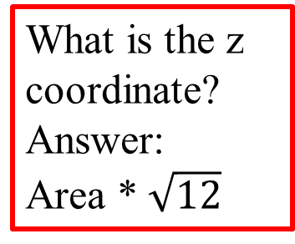
An interesting experiment
Compute side lengths normalized to a²+b²+c²=1
Plot (a²,b²,c²) in the plane x+y+z=1
Black=Obtuse Blue=Acute
Dot density largest near the perimeter
What is the z coordinate?
Answer:
Area * $\sqrt{12}$
Dot density = uniform on hemisphere as it appears to the eye from above

Slide 8
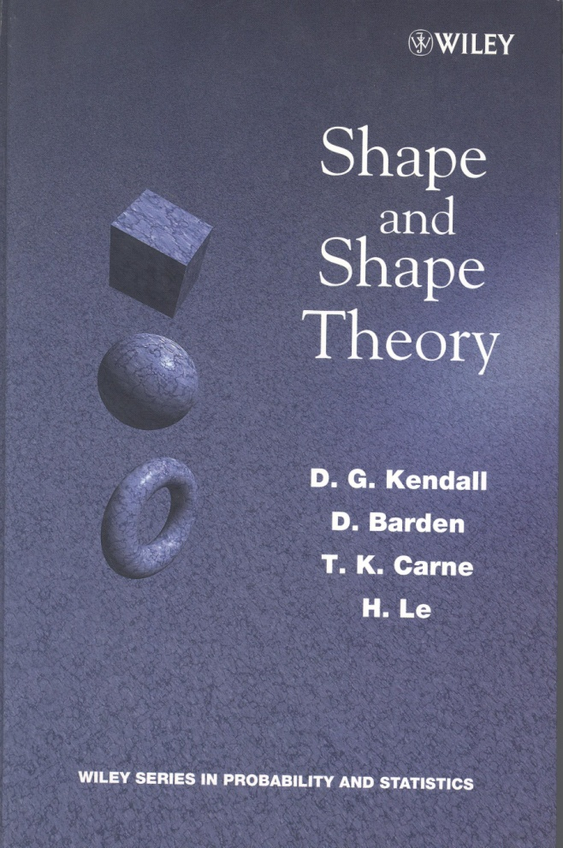
Kendall and others, “Shape Space”
Kendall “Father of modern probability theory in Britiain.
Explore statistically: historical sites are nearly colinear?
Shape Theory quotients out rotations and scalings
Kendall knew that triangle space with Gaussian measure was uniform on hemisphere

Slide 9
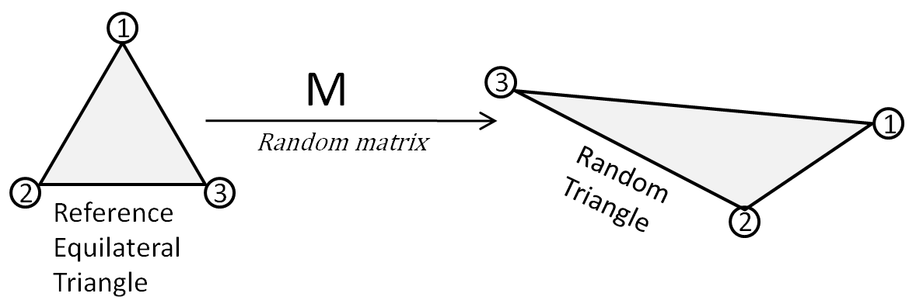
Connection to Numerical Linear Algebra
The problem is equivalent to knowing the condition number distribution of a random 2x2 matrix of normals normalized to Frobenius norm 1.
Identify M with the triangle

Slide 10
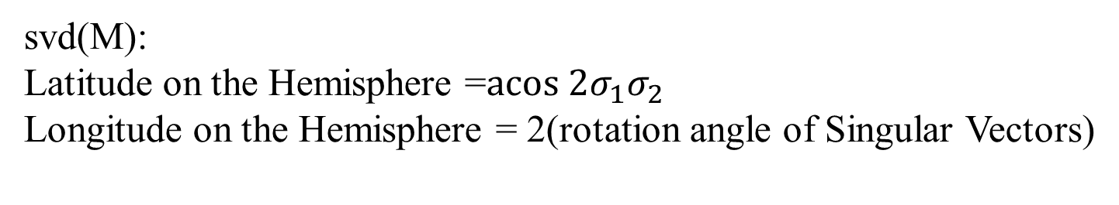
Connection to Shape Theory
svd(M):
Latitude on the Hemisphere =$acos {2σ}_{1}σ_{2}$
Longitude on the Hemisphere = 2(rotation angle of Singular Vectors)
right
^

Slide 11
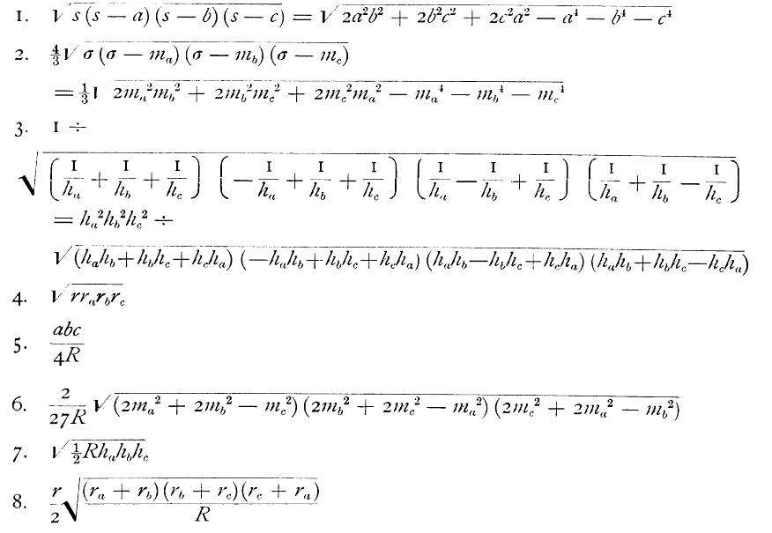
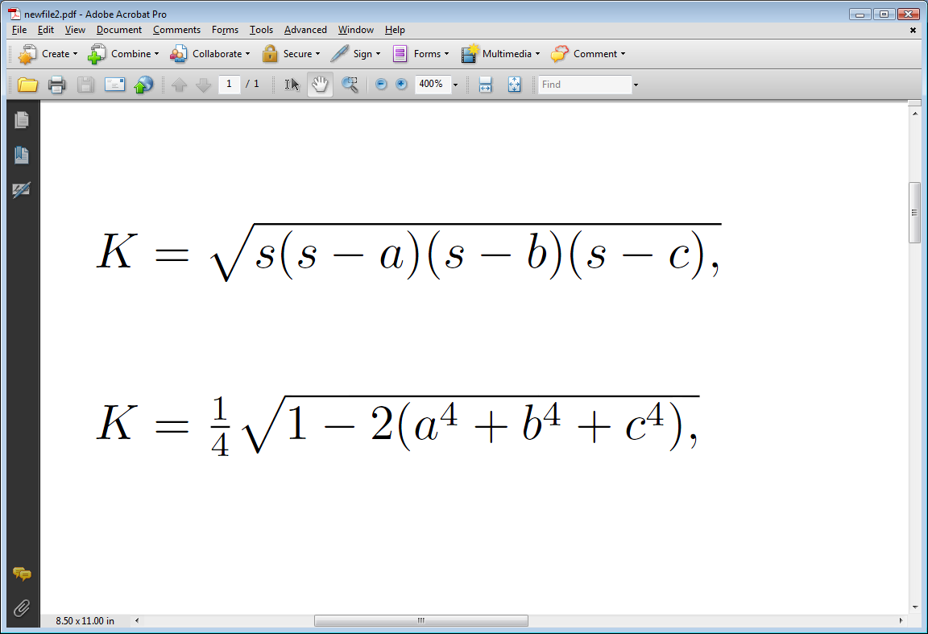
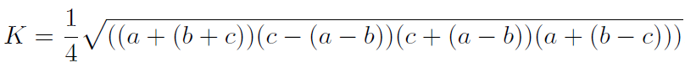
Area of a Triangle
Heron of Alexandria
Marcus Baker
139 Formulas
Annals of Math
1884/1885
s=(a+b+c)/2
a²+b²+c²=1
Kahan of Berkeley (Toronto really)
a ≥b≥ c

Slide 12
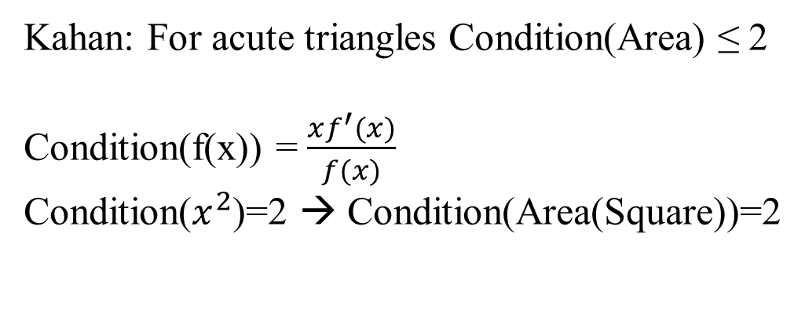
Conditioning
Condition(Area(a,b,c))=$\frac{Relative change in area}{Maximum relative change in side length}$
Kahan: For acute triangles Condition(Area) ≤ 2
Condition(f(x)) = $\frac{xf^{′}(x)}{f(x)}$
Condition($x^{2}$)=2 → Condition(Area(Square))=2
Perturbations = Scalings + ShapeChanges
Interpreting Kahan: For acute, ShapeChanges≤Scalings

Slide 13
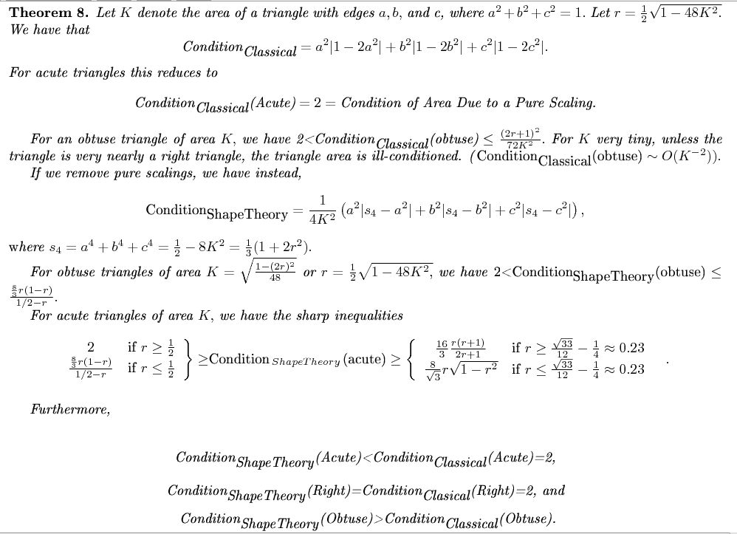

Slide 14
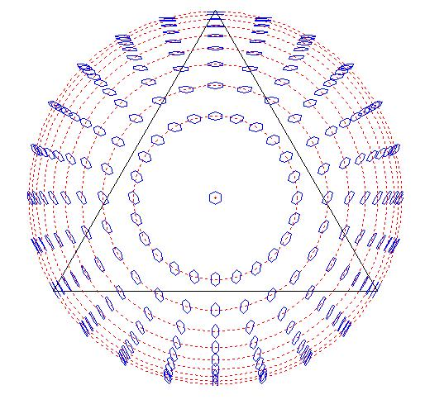
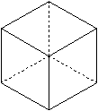
Perturbation Theory in Shape Space
Cube neighborhood projects onto a hexagon in shape space.
Needle-like acute
Triangle have neighborhoods
tangent to the latitude line
“head-on”
view removes scalings
Some hexagons penetrate the perimeter
=numerical violation of triangle inequality

Slide 15
Triangle Shape ←→
Points on the Hemisphere ←→
2x2 Matrices Normalized through SVD
Conclusion

Slide 16
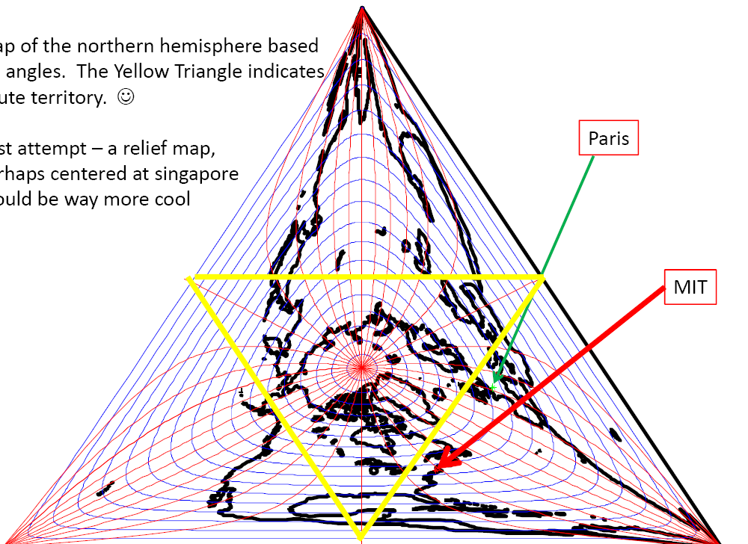
A Northern Hemisphere Map: Points mapped to angles
Acute Territory
HH11: Granlibakken

Slide 18
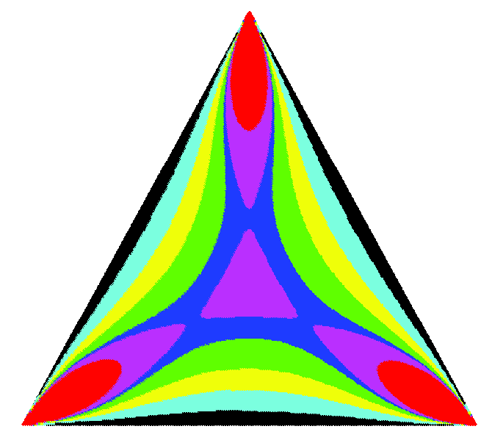
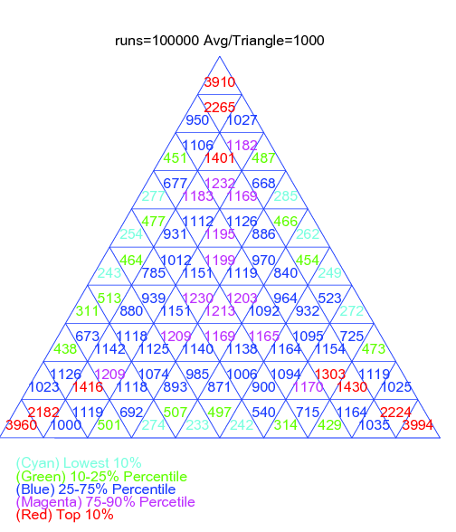
Angle Density (A+B+C=180)
theory
100,000 triangles in 100 bins
Not Uniform!

Slide 19
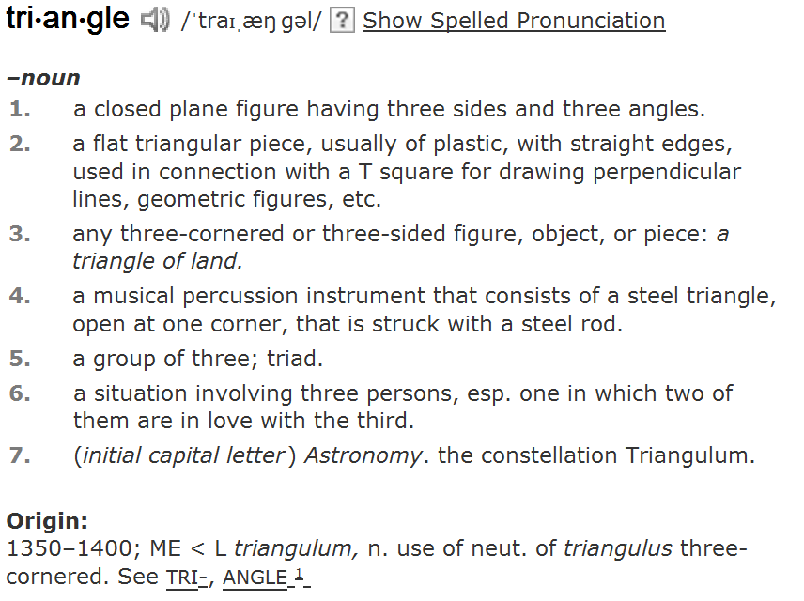
Please (in your mind) imagine a triangle

Slide 20
Another case/same answer: normals! P(acute)=¼
3 vertices x 2 coordinates =
6 independent Standard Normals
Experiment:
A=randn(2,3)
=triangle vertices
Not the same probability measure!
Open problem:give a satisfactory explanation of why both measures should give the same answer

Slide 21
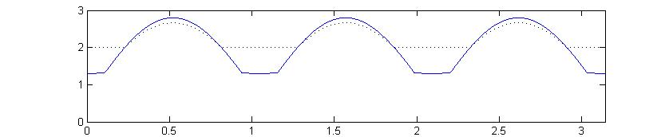
Shape Theory Conditioning vs Non Shape Theory for LargeAreas

Slide 22
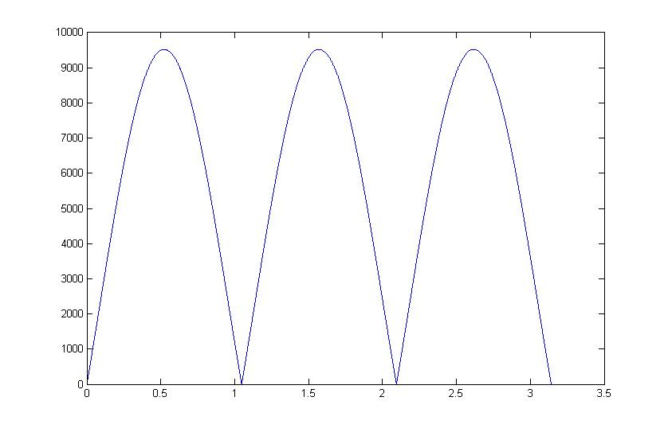
Tiny Area Triangles
Condition over a circle of latitude (Area=0.0024)
Condition
Longitude

Slide 23
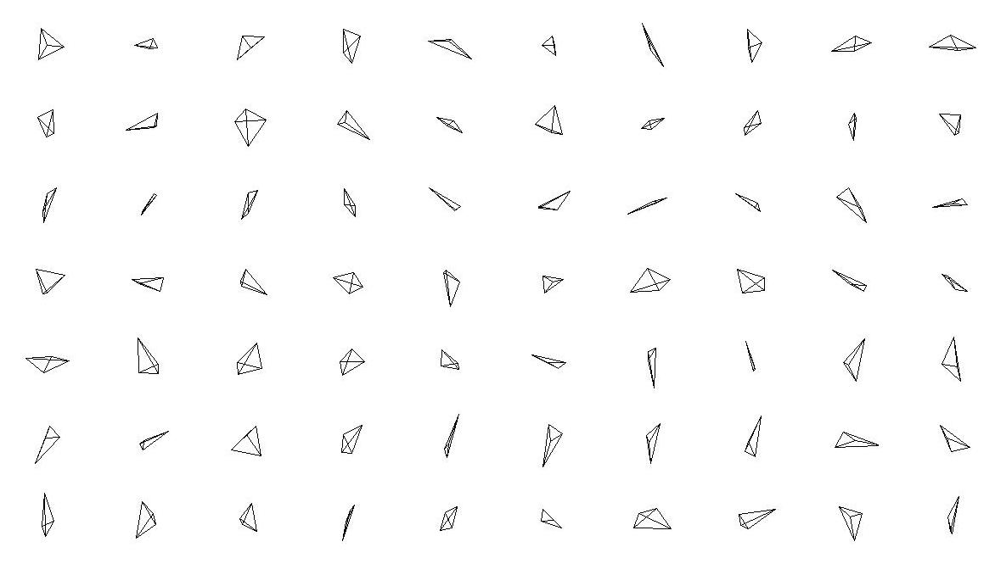
Random Tetrahedra
(Generalization uses randn(m,n)*Helmert Matrix)

Slide 24
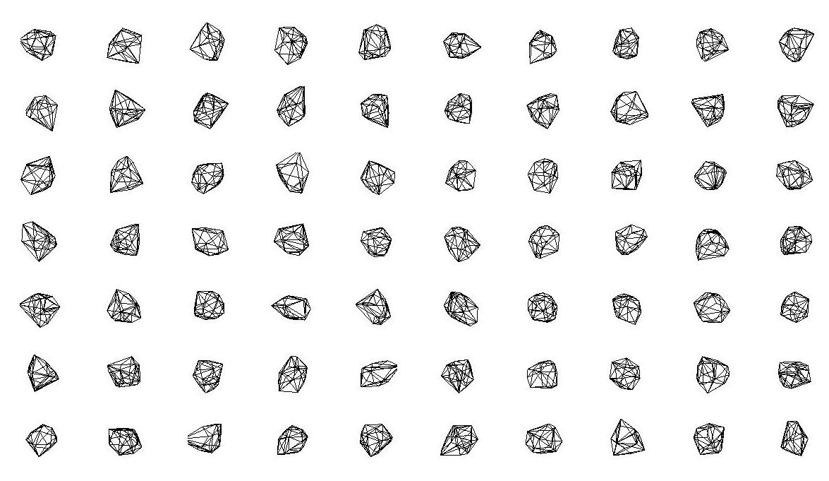
Random “Gems”
Convex Hulls (m=3, n=100)

Slide 25
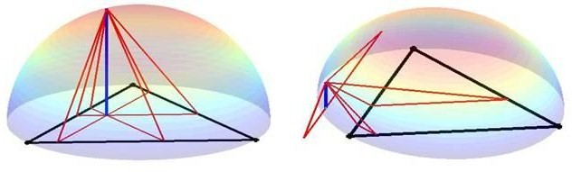
Construction of Triangle Shape
The three triangles with bases = parallelians through the a point on the sphere and its vertical projection are similar. They share the same height (in blue).

Slide 26
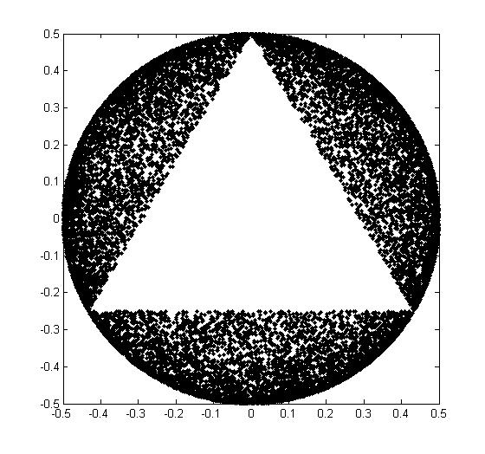
An interesting experiment
Compute side lengths normalized to a²+b²+c²=1
Plot (a²,b²,c²) when obtuse in the triangle x+y+z=1, x,y,z≥0.

Slide 27
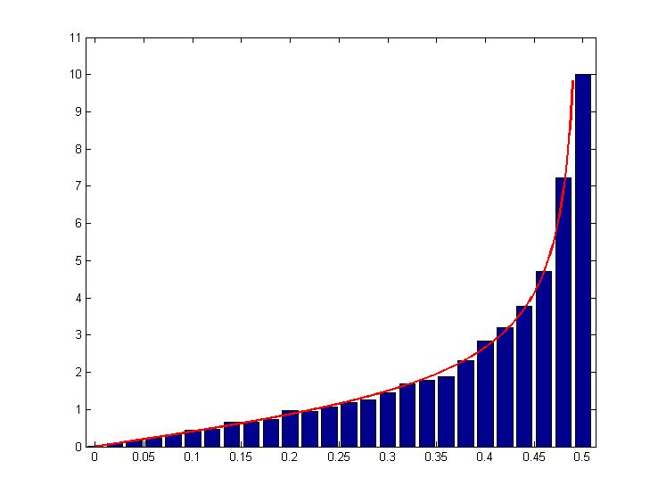
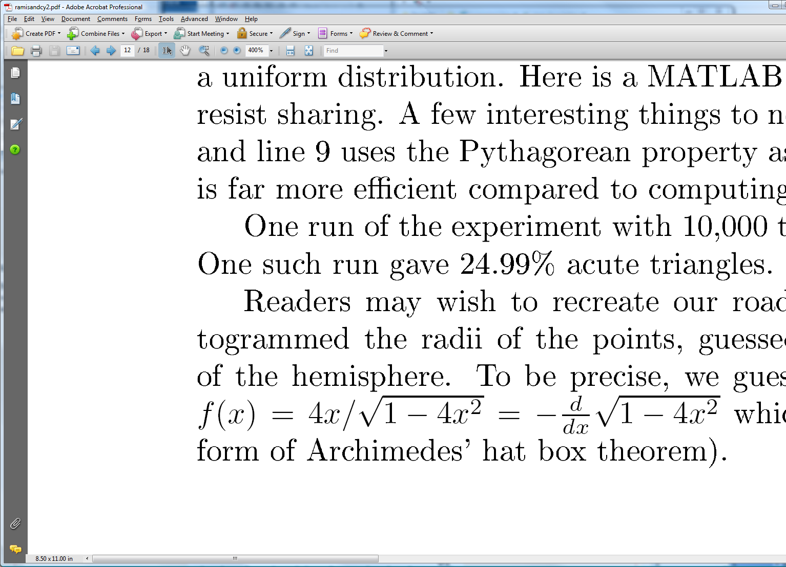
Uniform?
Distribution of radii:

Slide 28
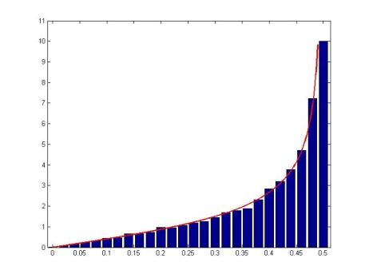
I remembered that the uniform distribution on the sphere means uniform Cartesian coordinates ➔
This picture wants to be on a hemisphere looking down

Slide 29
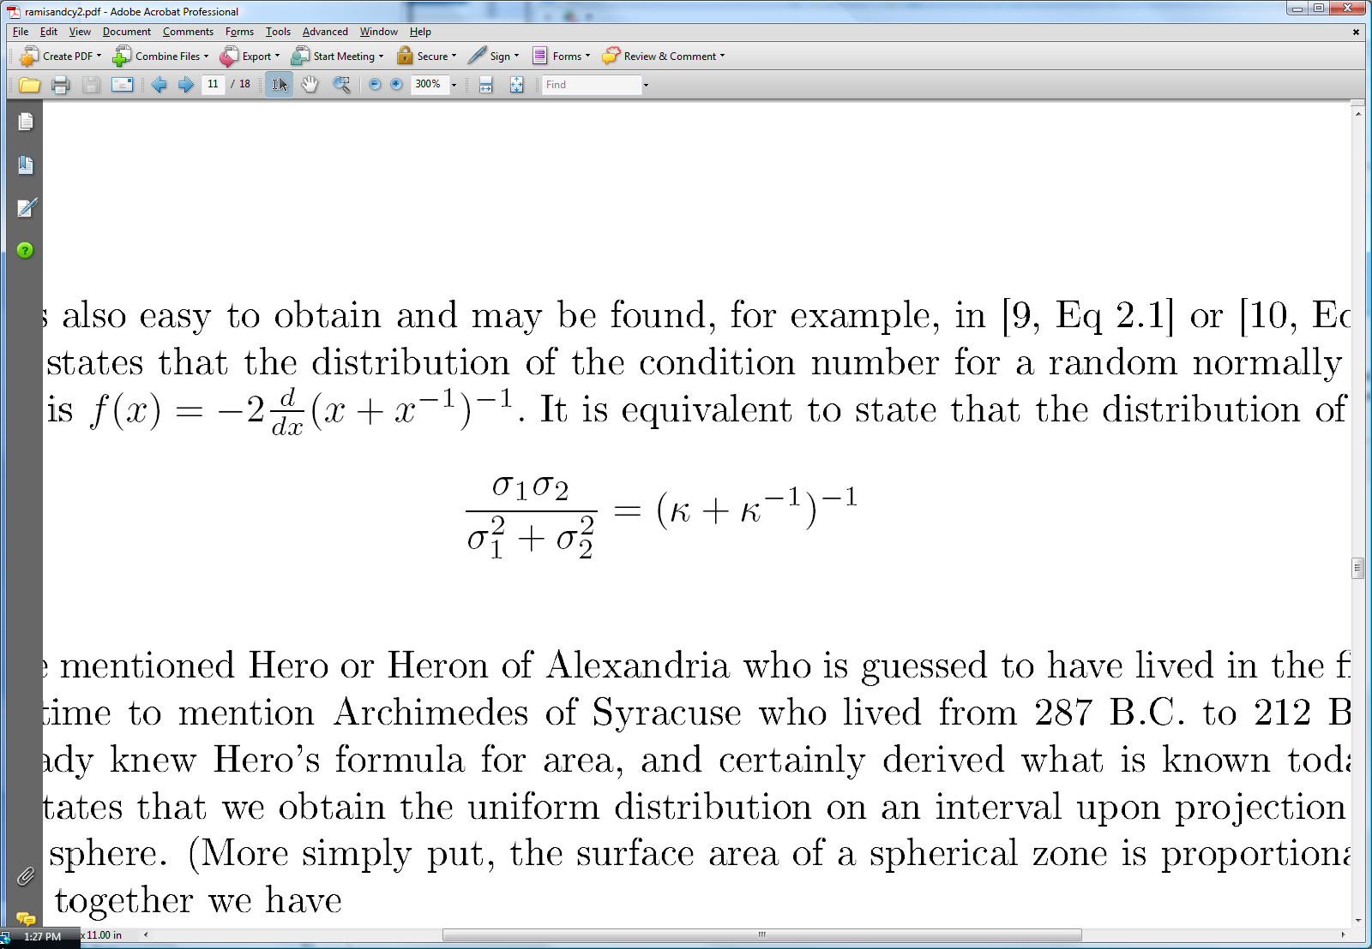
In Terms of Singular Values
A=(2x2 Orthogonal)(Diagonal)(Rotation(θ))
Longitude on hemisphere = 2θ
z-coordinate on hemisphere = determinant
Condition Number density (Edelman 89) =
Or the normalized determinant is uniform:
Also ellipticity statistic in multivariate statistics!

Slide 30
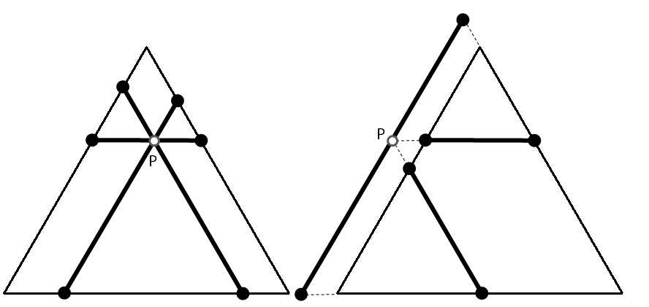
Triangle can be calculated but also can be geometrically constructed using parallelians
Parallelians through P

Slide 31
Question: For (n,m) what are the statistics for number of points in convex hull? Seems very small

Slide 32
Opportunities to use latest technology of random matrix theory
Zonal polynomials and hypergeometric functions of matrix argument

Slide 33
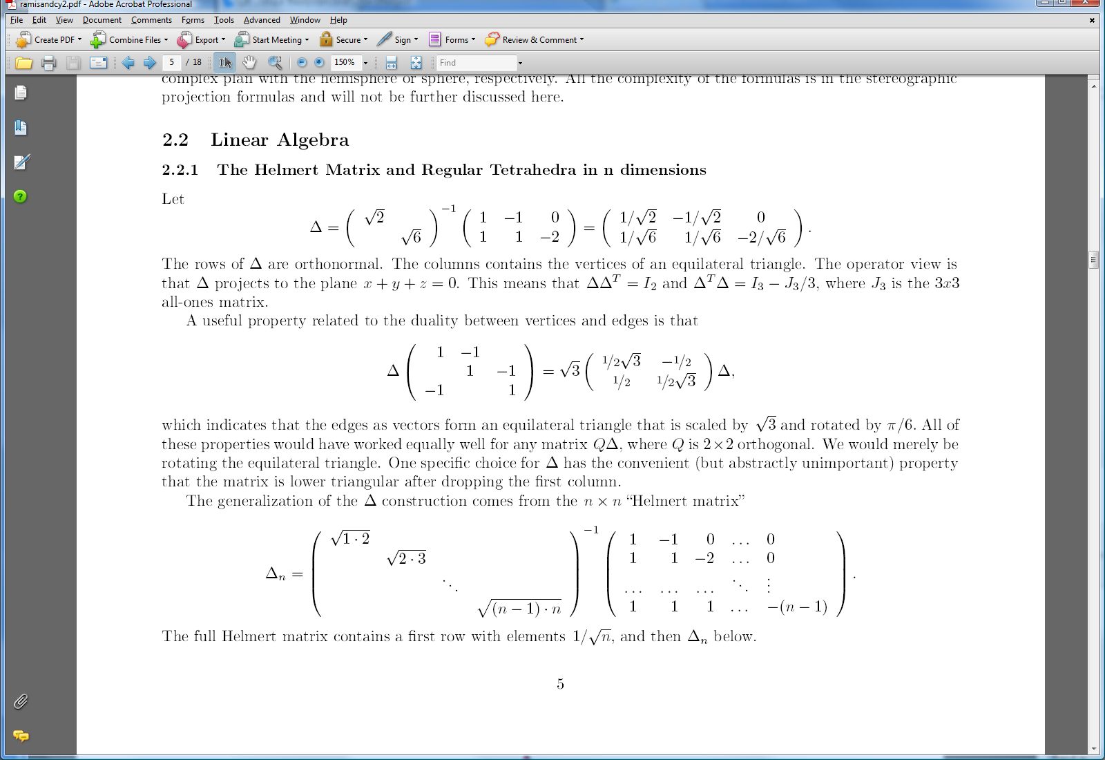
Generalized Approach with Helmart Matrix (Kendall)
What is a good way to construct the vertices of a regular simplex in n-dimensions?
Answer: Matrix orthogonal to (1,1,…,1)/sqrt(n)
Helmert Matrix:
randn(m,n-1)∆_{n}=n points in R^{m}

