Slide 1
What is Scientific Machine Learning?
Chris Rackauckas
Massachusetts Institute of Technology, Department of Mathematics
University of Maryland, Baltimore, School of Pharmacy, Center for Translational Medicine

Slide 2
Scientific ML/AI is Domain Models with Integrated Machine Learning

Slide 3
Mechanistic vs Non-Mechanistic Models
Let’s say we want to define a nonlinear model for the population of rabbits. There are three basic ways to do this:
$$Rabbits tomorrow=Model(Rabits today)$$
Analytical solutions require that someone explicitly define a nonlinear model. Clearly doesn’t scale.
Differential equations describe mechanisms/structure and let the equations naturally evolve from this description
$Rabbits^{′}(t)=αRabbits(t)$ encodes “the rate at which the population is growing depends on the current number of rabbits”.
Machine learning models specify a learnable black box, where with the right parameters they can fit any nonlinear function.
Which is best?

Slide 4
Pros and Cons of Mechanistic Models
Mechanistic models understand the structure, so they can extrapolate far beyond data
Einstein’s equations described black holes, and area of parameter space with infinities, decades before we could ever get data on them!
Mechanistic models are interpretable, can be extended, transferred, analytically understood.
Mechanistic models require that you know mechanism
Data goes through a filter of experts. Scientists need to confirm every term.
Non-mechanistic models can give a very predictive model directly from data, but without the interpretability or extrapolatability of mechanistic models.
Neither is better than the other. Both have advantages.
Goal: Combine mechanistic and non-mechanistic models in ways that one receives the best of both worlds.

Slide 5
Convolutional Neural Networks Are Structure Assumptions

Slide 6
Universal Approximation Theorem
Neural Networks can get $ε$ close to any $R^{n}→R^{m}$ function
Neural networks are just function expansions, fancy Taylor Series like things which are good for computing and bad for analysis

Slide 7
Neural Networks = Function Approximation
Polynomial: $e^{x}=1+\frac{x}{1!}+\frac{x^{2}}{2!}+…$
Nonlinear: $e^{x}=1+\frac{2\tanh\left(\frac{x}{2}\right)}{1−\tanh\left(\frac{x}{2}\right)}$
Neural Network: $e^{x}≈W_{3}σ\left(W_{2}σ\left(W_{1}x+b_{1}\right)+b_{2}\right)+b_{3}$

Slide 8
Neural Networks = Nonlinear Regression
Polynomial: $e^{x}=a_{1}+a_{2}x+a_{3}x^{2}+…$
Nonlinear: $e^{x}=1+\frac{a_{1}\tanh\left(a_{2}x\right)}{a_{3}x−\tanh\left(a_{4}x\right)}$
Neural Network: $e^{x}≈W_{3}σ\left(W_{2}σ\left(W_{1}x+b_{1}\right)+b_{2}\right)+b_{3}$. Train the weights $(W,b)$

Slide 9
Other Universal Approximators
Polynomials: easy but numerically unstable and Runge’s Phenomenon
Fourier/Chebyshev Series: great if smooth, but Gibb’s Phenomenon.
Going to higher dimensions usually isn’t rotationally invariant: mixed derivatives give issues.
Tensor product spaces
Sparse Grids
Radial Basis Functions (RBFs) work well on low dimensional manifolds in high dimensional spaces
Nothing is really a silver bullet for arbitrary functions in high dimensions.
[1] L. N. Trefethen, Cubature, approximation, and isotropy in the hypercube, SIAM Review
[2] https://www.cs.cmu.edu/afs/cs/academic/class/15883-f17/slides/rbf.pdf

Slide 10
Neural Networks are universal approximators which work well in high dimensions
Neural Networks Overcome “the curse of dimensionality”

Slide 11
What’s out there on SciML?
https://icerm.brown.edu/events/ht19-1-sml/
https://www.osti.gov/biblio/1478744-workshop-report-basic-research-needs-scientific-machine-learning-core-technologies-artificial-intelligence
http://www.cs.colorado.edu/~paco3637/sciml-refs.html
http://www.smartchair.org/hp/MSML2020/TOP/
https://www.stochasticlifestyle.com/the-essential-tools-of-scientific-machine-learning-scientific-ml/
https://arxiv.org/abs/1907.07587
https://www.youtube.com/watch?v=FGfx8CQHdQA

Slide 12
A few results in the field

Slide 13
Let’s solve ODEs and PDEs with Neural Networks (Blackboard time!)

Slide 14
Physics-informed neural networks: A deep learning framework for solving forward and inverse problems involving nonlinear partial differential equations
M.Raissi, P.Perdikaris, & G.E.Karniadakis
We introduce physics-informed neural networks – neural networks that are trained to solve supervised learning tasks while respecting any given laws of physics described by general nonlinear partial differential equations. In this work, we present our developments in the context of solving two main classes of problems: data-driven solution and data-driven discovery of partial differential equations. Depending on the nature and arrangement of the available data, we devise two distinct types of algorithms, namely continuous time and discrete time models. The first type of models forms a new family of data-efficient spatio-temporal function approximators, while the latter type allows the use of arbitrarily accurate implicit Runge–Kutta time stepping schemes with unlimited number of stages. The effectiveness of the proposed framework is demonstrated through a collection of classical problems in fluids, quantum mechanics, reaction–diffusion systems, and the propagation of nonlinear shallow-water waves.

Slide 15
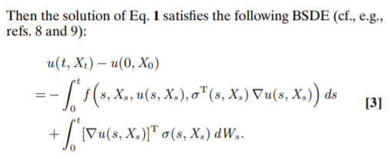
Solving 1000 dimensional PDEs: Hamilton-Jacobi-Bellman, Nonlinear Black-Scholes
Semilinear Parabolic Form
Make $(σ^{T}∇u)\left(t,X\right)$ a neural network.
Solve the resulting SDEs and learn $σ^{T}∇u$ via:
Diffusion-advection PDEs can be transformed into stochastic differential equations for high dimensional solving (Feynman-Kac, Forward Kolmogorov)
What about more general semilinear parabolic PDEs? Hamilton-Jacobi-Bellman, Nonlinear Black-Scholes.
Transform it into a Backwards SDE: a stochastic boundary value problem. The unknown is a function!
Learn the unknown function via neural network.
Solve the forward problem 1,000,000 times to get a probability distribution, this distribution is the PDE’s solution
Solving high-dimensional partial differential equations
using deep learning, 2018, PNAS, Han, Jentzen, E

Slide 16
Stochastic RNN Formulation

Slide 17
Deep learning for universal linear embeddings of nonlinear dynamics
Bethany Lusch, J. Nathan Kutz, & Steven L. Brunton
Identifying coordinate transformations that make strongly nonlinear dynamics approximately linear has the potential to enable nonlinear prediction, estimation, and control using linear theory. The Koopman operator is a leading data-driven embedding, and its eigenfunctions provide intrinsic coordinates that globally linearize the dynamics. However, identifying and representing these eigenfunctions has proven challenging. This work leverages deep learning to discover representations of Koopman eigenfunctions from data. Our network is parsimonious and interpretable by construction, embedding the dynamics on a low-dimensional manifold. We identify nonlinear coordinates on which the dynamics are globally linear using a modified auto-encoder. We also generalize Koopman representations to include a ubiquitous class of systems with continuous spectra. Our framework parametrizes the continuous frequency using an auxiliary network, enabling a compact and efficient embedding, while connecting our models to decades of asymptotics. Thus, we benefit from the power of deep learning, while retaining the physical interpretability of Koopman embeddings.

Slide 18
DGM: A deep learning algorithm for solving partial differential equations
Justin Sirignano and Konstantinos Spiliopoulos
High-dimensional PDEs have been a longstanding computational challenge. We propose to solve highdimensional PDEs by approximating the solution with a deep neural network which is trained to satisfy the differential operator, initial condition, and boundary conditions. Our algorithm is meshfree, which is key since meshes become infeasible in higher dimensions. Instead of forming a mesh, the neural network is trained on batches of randomly sampled time and space points. The algorithm is tested on a class of high-dimensional free boundary PDEs, which we are able to accurately solve in up to 200 dimensions. The algorithm is also tested on a high-dimensional Hamilton-Jacobi-Bellman PDE and Burgers’ equation. The deep learning algorithm approximates the general solution to the Burgers’ equation for a continuum of different boundary conditions and physical conditions (which can be viewed as a high-dimensional space). We call the algorithm a “Deep Galerkin Method (DGM)” since it is similar in spirit to Galerkin methods, with the solution approximated by a neural network instead of a linear combination of basis functions. In addition, we prove a theorem regarding the approximation power of neural networks for a class of quasilinear parabolic PDEs.

Slide 19
In Turn, Scientific Computing is Impacting Machine Learning

Slide 20
Two equivalences: CNNs and PDEs, RNNs and ODEs (Blackboard time)

Slide 21
Deep Neural Networks Motivated by Partial Differential Equations
Lars Ruthotto and Eldad Haber
Partial differential equations (PDEs) are indispensable for modeling many physical phenomena and also commonly used for solving image processing tasks. In the latter area, PDE-based approaches interpret image data as discretizations of multivariate functions and the output of image processing algorithms as solutions to certain PDEs. Posing image processing problems in the infinite dimensional setting provides powerful tools for their analysis and solution. Over the last few decades, the reinterpretation of classical image processing problems through the PDE lens has been creating multiple celebrated approaches that benefit a vast area of tasks including image segmentation, denoising, registration, and reconstruction. In this paper, we establish a new PDE-interpretation of a class of deep convolutional neural networks (CNN) that are commonly used to learn from speech, image, and video data. Our interpretation includes convolution residual neural networks (ResNet), which are among the most promising approaches for tasks such as image classification having improved the state-of-the-art performance in prestigious benchmark challenges. Despite their recent successes, deep ResNets still face some critical challenges associated with their design, immense computational costs and memory requirements, and lack of understanding of their reasoning. Guided by well-established PDE theory, we derive three new ResNet architectures that fall into two new classes: parabolic and hyperbolic CNNs. We demonstrate how PDE theory can provide new insights and algorithms for deep learning and demonstrate the competitiveness of three new CNN architectures using numerical experiments.

Slide 22
Neural Ordinary Differential Equations
Ricky T. Q. Chen, Yulia Rubanova, Jesse Bettencourt, David Duvenaud
We introduce a new family of deep neural network models. Instead of specifying a discrete sequence of hidden layers, we parameterize the derivative of the hidden state using a neural network. The output of the network is computed using a black-box differential equation solver. These continuous-depth models have constant memory cost, adapt their evaluation strategy to each input, and can explicitly trade numerical precision for speed. We demonstrate these properties in continuous-depth residual networks and continuous-time latent variable models. We also construct continuous normalizing flows, a generative model that can train by maximum likelihood, without partitioning or ordering the data dimensions. For training, we show how to scalably backpropagate through any ODE solver, without access to its internal operations. This allows end-to-end training of ODEs within larger models.

Slide 23
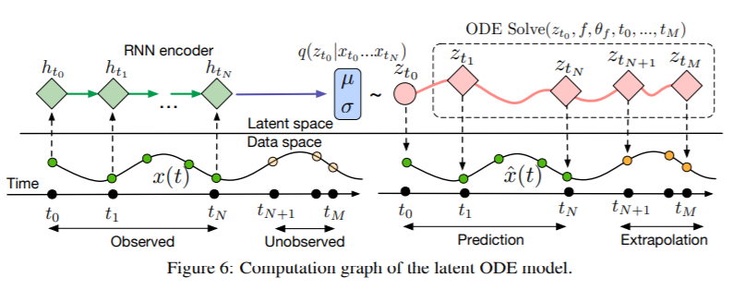
ODEs Generalize RNNs

Slide 24
Some of my recent work

Slide 25
Universal Differential Equations
Replace the user-defined structure with a neural network, and learn the nonlinear function for the structure.
Neural ordinary differential equation: $u^{′}=f(u,p,t)$. Let $f$ be a neural network.
Why would we expect this to work? What is it actually doing?

Slide 26
Automatically Learning the Model

Slide 27
Ecology Example: Lotka-Volterra Equations
$$\frac{d🐇}{dt}=α🐇−β🐇🐺 \\ \frac{d🐺}{dt}=δ🐇🐺−γ🐺$$
Exponential growth
Gets eaten
by wolves
Increases with more food
Decreases with competition

Slide 28
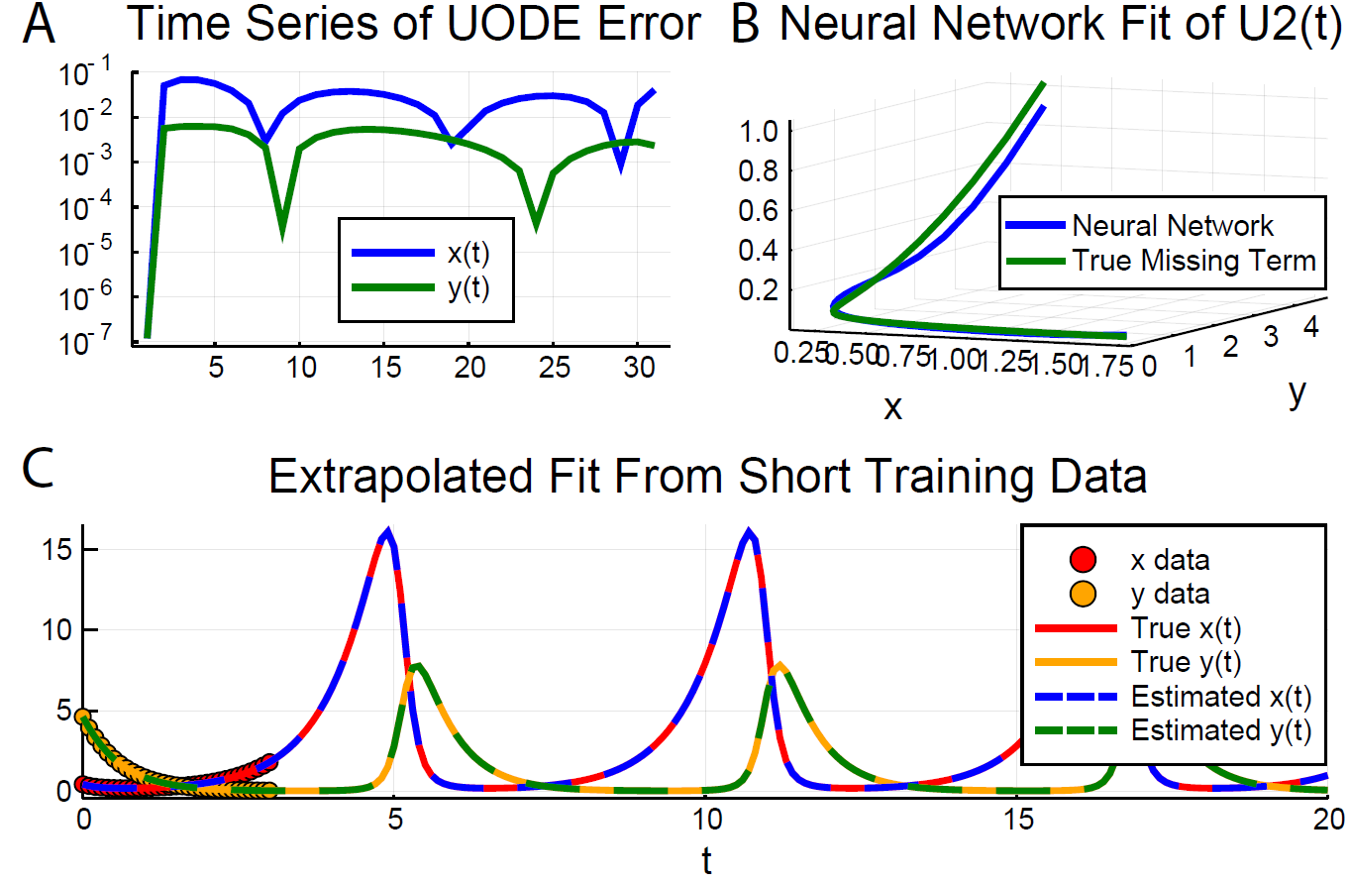
Universal ODEs learn and extrapolate Lotka-Volterra from small data!
Truth
Partially-known neural embedded equations
Automatically recover the long term behavior
from less than half of a period in a cyclic
time series!
Turn neural networks back into equations with SInDy

Slide 29
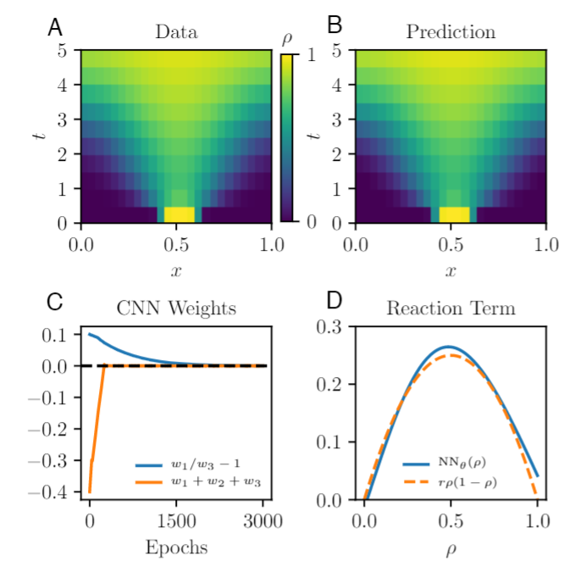
Automatically Learning PDEs from Data: Universal PDEs for Fisher-KPP
Truth: Fisher-KPP Equations
Truth: Universal Differential Equation
Automatically recover that the dynamical system
has a diffusion operator and a quadratic reaction
term!

Slide 30
Universal SDEs: Nonlinear Timeseries Learning and Extrapolation
DiffEqFlux.jl was the first software to be able to fit neural stochastic differential equations. These are neural differential equations with a deterministic and stochastic evolution:
$$du_{t}=f\left(u,p,t\right)dt+g\left(u,p,t\right)dW_{t}$$
Allows for direct training and discovery of financial “quant” models

Slide 31
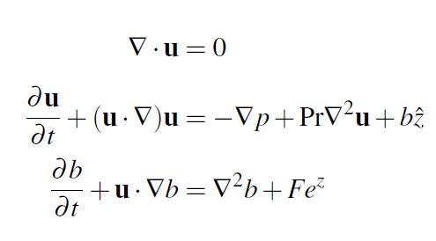
Universal PDEs for Acceleration: Automated Climate Parameterizations
Boussinesq Equations (Navier-Stokes) are used in climate models
People attempt to solve this by “parameterizing”, i.e. getting a 1-dimensional approximation through averaging:
where $\overline{w^{′}c′}$ is unknown.
Instead of picking a form for $\overline{w^{′}c′}$(the current method), replace it with a neural network and learn it from small scale simulations! Discretize. Result: Neural ODE.

Slide 32
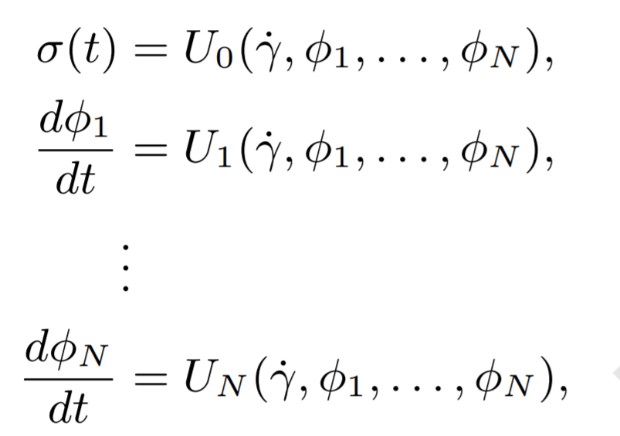
Universal ODEs Accelerate Non-Newtonian Fluid Simulations

Slide 33
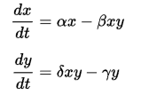
Neural Network Surrogates for Real-Time Nonlinear Approximate Control
Problem: Given alpha and delta,
give me beta and gamma such
that the solution stays in [0,6]

Slide 34
A Complimentary Inversion Network
Cost function is evaluated against the previous network
Trained neural net procedure:
Take N random numbers
Throw each through the neural net
Predict the chance that the result satisfies the condition from the neural net 1
Choose the choice which has the highest chance
Random

Slide 35
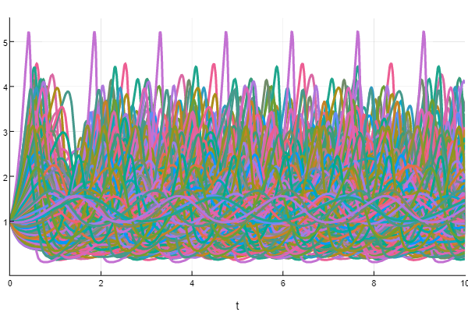
Inversion is accurate and independent of simulation time
1999/2000 correct … but adapt data (infinite data!) …
2000/2000 correct

Slide 36
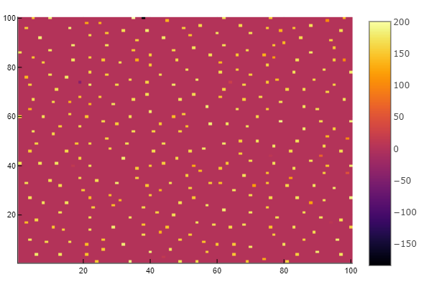
Scales to PDEs: Gierer-Meinhardt Equations
Can train neural networks to “instantly” find parameters that will allow biological organisms to have spots

Slide 37
Solving 1000 dimensional PDEs: Hamilton-Jacobi-Bellman, Nonlinear Black-Scholes
Semilinear Parabolic Form (Diffusion-Advection Equations, Hamilton-Jacobi-Bellman, Black-Scholes)
Make $(σ^{T}∇u)\left(t,X\right)$ a neural network.
Solve the resulting SDEs and learn $σ^{T}∇u$ via:
Simplified:
Transform it into a Backwards SDE: a stochastic boundary value problem. The unknown is a function!
Learn the unknown function via neural network.
Once learned, the PDE solution is known.
Solving high-dimensional partial differential equations
using deep learning, 2018, PNAS, Han, Jentzen, E

Slide 38
Stochastic RNN Formulation

Slide 39
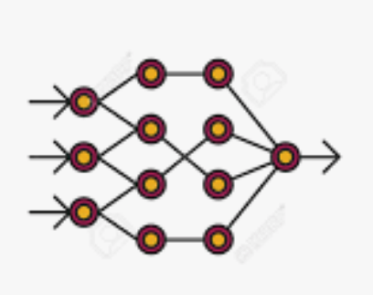
But this method can be represented as a neural SDE
That method is the fixed time-step Euler-Maruyama method on
As a neural SDE, we can solve with higher order (less neural network evaluations), adaptivity, etc.

Slide 40
Many other domain-specific uses
Automatically learn gene regulatory networks, then test against models to determine the best fit.
Automatically learn time series models (without stationarity assumptions) and then extrapolate by solving the neural stochastic differential equation longer.
Automatically guess relationships between materials measurements and mechanisms for better battery development.
Etc. etc.
A horde of papers are being written which utilize these tools as their core. Seeking more collaborators!

Slide 41
Scaling the software to “real” problems
Neural ODE with batching on the GPU (without internal data transfers) with high order adaptive
implicit ODE solvers for stiff equations using matrix-free Newton-Krylov via preconditioned GMRES
and trained using checkpointed adjoint equations.

Slide 42
Do you want to research numerical differential equations and Scientific AI?
Looking for collaborators for Julia-wide scientific ecosystem development grants
Students are welcome! Contact me for Google Summer of Code, Julia Seasons of Contributions, or Pumas development. No Julia experience is required. Just jump right into the chat channels (https://gitter.im/JuliaDiffEq/Lobby) and we can find you an appropriate project.
https://julialang.org/soc/ideas-page
If you’re a hobbyist… join our chats! Fit models! Stop by the MIT Julia Lab!

