Slide 1


Beta Jacobi Ensembles, (ghosts) and the GSVD
Alan Edelman (MIT)
(with Yuyang Wang (Amazon))
Aprl 11, 2016

Slide 2
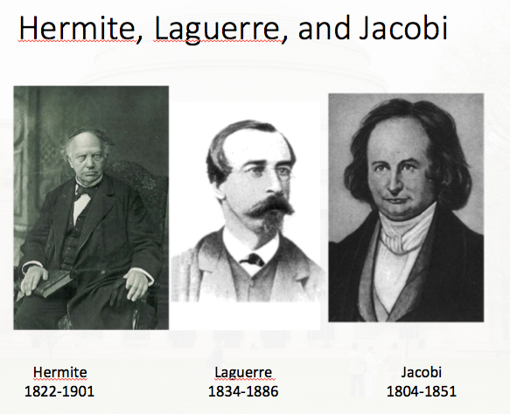

Two Big Ideas I enjoy mulling over
1. Deep significance of Hermite/Laguerre/Jacobi
Hermite | eig | symmetric eigenvalue problem
Laguerre | svd | singular value decomposition
Jacobi | gsvd | generalized singular value decomposition
not 1,2,4 or even integer
has a ghost like existence
Today want to emphasize its
Appearance in
Selberg Constants
Differential Geometry
Jacobian Computations
Beta is
NOT
just
1,2,4 anymore
I believe
in beta
2. Ghosts

Slide 3
Beta Ensembles
Real
dimensions
 | One real dimension | 1
 | One complex dimension | 2
 | One quaternion dimension | 4
 | One ghost beta dimension

Slide 4
Do you recognize this sequence?

Slide 5
Do you recognize this sequence?

Slide 6
Do you recognize this sequence?

Slide 7
Do you recognize this sequence?

Slide 8
Do you recognize this sequence?
Volume (surface area) of the unit hypersphere in n real dimensions

Slide 9
Do you recognize this sequence?
Volume (surface area) of the unit hypersphere in n real dimensions
Volume (surface area) of the unit hypersphere in 1 beta dimension

Slide 10
Do you recognize this sequence?
Volume (surface area) of the unit hypersphere in n real dimensions
Volume (surface area) of the unit hypersphere in 1 beta dimension
Scalar

Slide 11
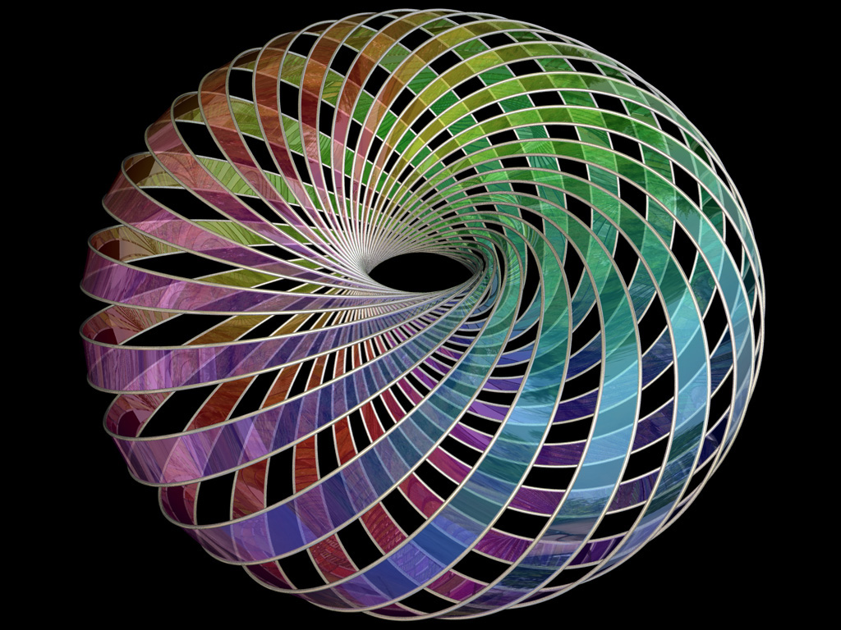
Pictures of (Same as )
Rendition: Hopf Fibration

Slide 12
Pictures of (Same as )
Rendition: Hopf Fibration
(See E and Mangoubi Ghost Hopf fibration)
Mangoubi thesis (being finished now)

Slide 13
Volumes
Volume (surface area) of the unit hypersphere in n real dimensions
Volume (surface area) of the unit hypersphere in 1 beta dimension
Volume (surface area) of the unit hypersphere in n beta dimensions

Slide 14
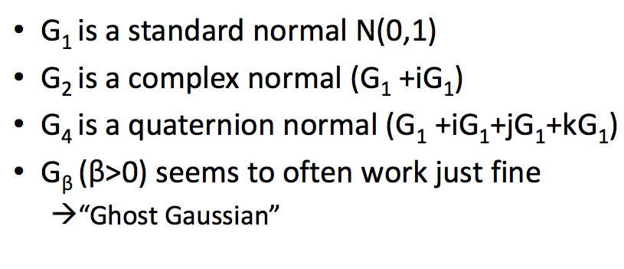
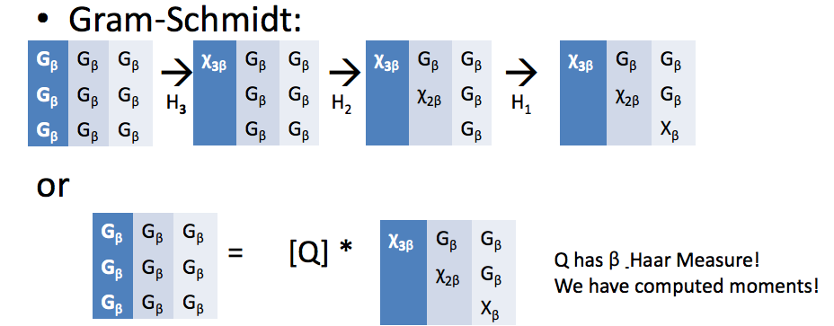
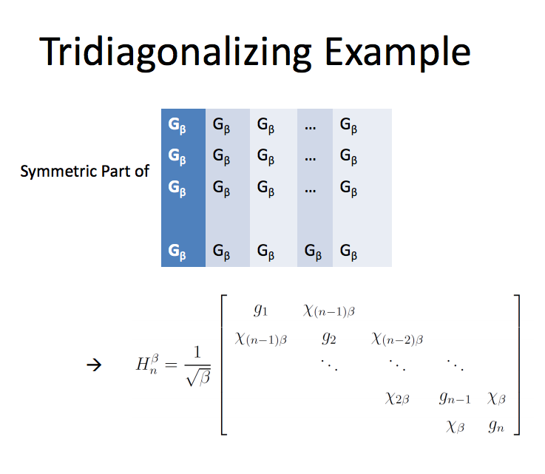
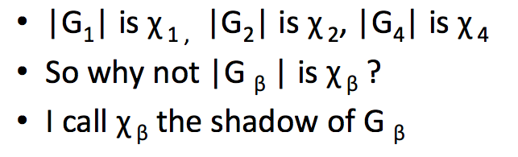
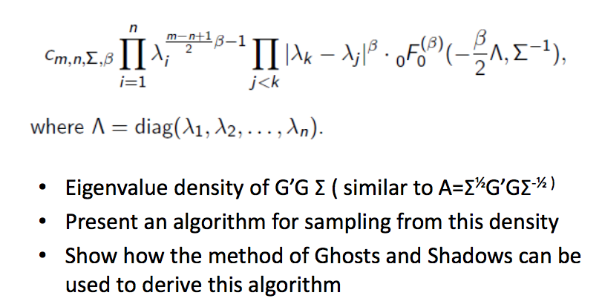
Ghosts and Shadows “Collage”
Stochastic Operator Limit 2003
d
2
2
−
x
+
dW
,
dx
2
β

Slide 15
Jacobi Ensembles Traditional Form
Suppose A and B are randn(m1,n) and randn(m2,n)
  iid standard normals, let’s assume m1 and m2 >= n
The eigenvalues of the “MANOVA” matrix
Or in Symmetric Form

Slide 16
Jacobi Ensembles Traditional Form
Suppose A and B are randn(m1,n) and randn(m2,n)
  iid standard normals, let’s assume m1 and m2 >= n
The eigenvalues of
Joint Eigenvalue Distribution (1939):

Slide 17
Jacobi Ensembles
Compute the eigenvalues of
[~,~,~,c,s] = gsvd(randn(m1,n),randn(m2,n))
eigs = c^2

Slide 18

The Jacobi Ensemble:
Geometric Interpretation
Take reference dimensional subspace of
Take random dimensional subspace of
Jacobi ensemble
The shadow of the unit ball in the random subspace when projected onto the reference subspace is an ellipsoid
The semi-axes lengths are the Jacobi ensemble cosines.
(MANOVA Convention=Squared cosines)

Slide 19
Stiefel Manifold :
set of n-dim (orthonormal) frames in
Equivalence Class =

Slide 20
Stiefel Manifold (Num. Lin. Alg.)
set of n-dim (orthonormal) frames in
=
Tall skinny
orthogonal matrix
Householder matrices
From the Numerical Linear Algebra point of view …

Slide 21
Stiefel Manifold (Num. Lin. Alg.)
set of n-dim (orthonormal) frames in
=
=

Slide 22
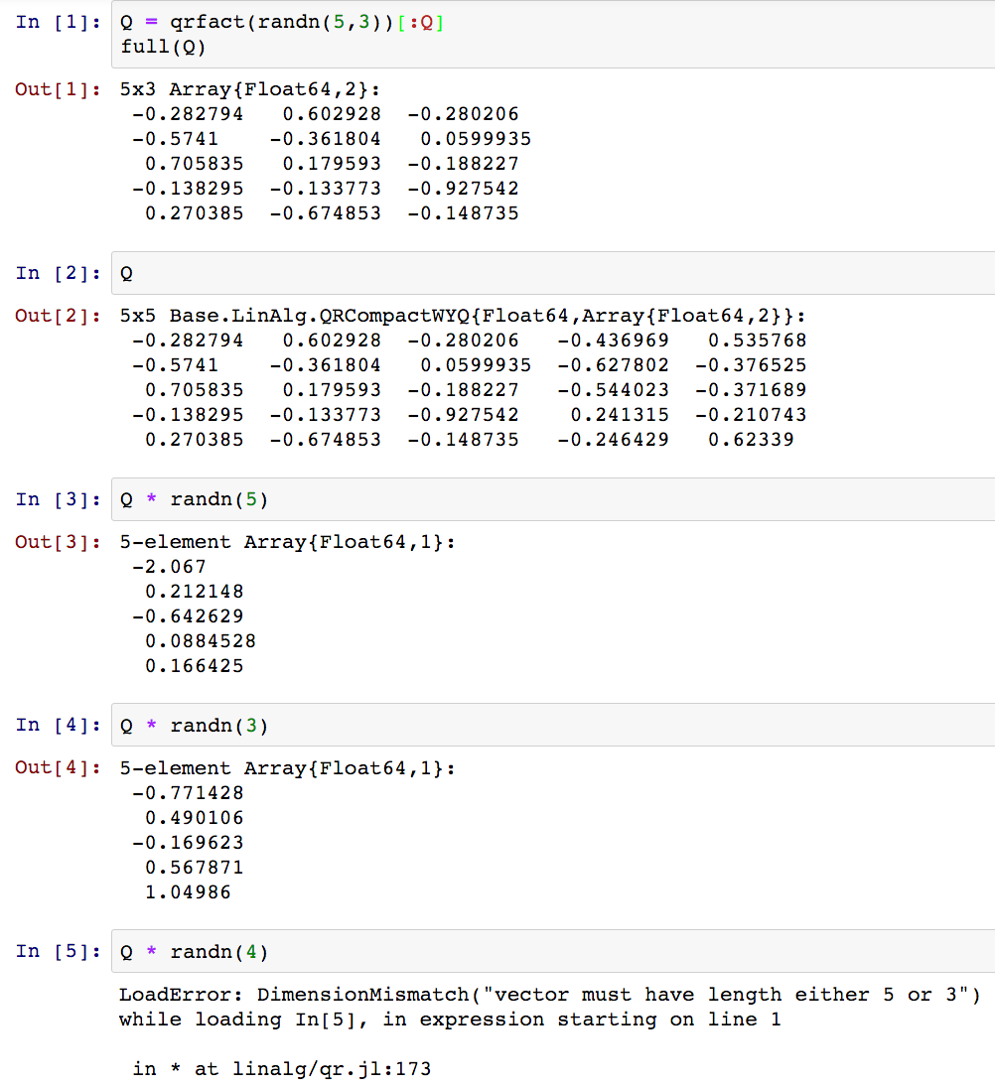

Q = Stiefel point
Details:
WY Representation
Schreiber and van Loan
1989
But product of Householders
Is much older

Slide 23
Volume of the Stiefel Manifold

Slide 24
Volume of the Stiefel Manifold

Slide 25
AVOID square root eigs of !
Laguerre

Slide 26
=
Given a set of distinct singular values

Slide 27
=
Given a set of distinct singular values
Notes:
\color[rgb]{0.000000,0.458647,0.000000}\mathcal{O}(n)

Slide 28
=
Given a set of distinct singular values
Notes:
\color[rgb]{0.000000,0.458647,0.000000}\mathcal{O}(n)

Slide 29
=
Given a set of distinct singular values
Notes:
\color[rgb]{0.000000,0.458647,0.000000}\mathcal{O}(n)

Slide 30
=
Given a set of distinct singular values
Notes:
\color[rgb]{0.000000,0.458647,0.000000}\mathcal{O}(n)

Slide 31
Volume Cheat Sheet ( )

Slide 32
SVD Jacobian
The Players
The Differential

Slide 33
Diagonal
Rectangle
Anti-symmetric

Slide 34
Diagonal
Rectangle
Anti-symmetric

Slide 35
Diagonal
Rectangle
Anti-symmetric

Slide 36
Diagonal
Rectangle
Anti-symmetric
Diagonal 0 when

Slide 37
Diagonal
Rectangle
Anti-symmetric
Laguerre

Slide 38
Integration over Stiefel Manifold

Slide 39
Stiefel Manifold : Encodings
set of n-dim (orthonormal) frames in
Tall Skinny
Equivalence Class =
Full orthogonal

Slide 40
Grassmann Manifold : Encodings
set of n-dim subspaces in
Equivalence Class =
Tall Skinny
Equivalence Class =
Full orthogonal

Slide 41
Volume Cheat Sheet ( )

Slide 42
Volume Cheat Sheet

Slide 43
Constant in Integration for Laguerre Ensemble for general beta
=
only tricky part is the symmetric matrices in the differential and only the diagonals

Slide 44
Grassmann with Matrices

Slide 45
Grassmann with Matrices
Orthogonal Representations
General Representations

Slide 46
Grassmann with Matrices
Orthogonal Representations
General Representations
Uniform
Random Subspace

Slide 47
Grassmann with Matrices
Orthogonal Representations
General Representations
Partial CS
Or Partial GSVD
Uniform
Random Subspace
CS
GSVD

Slide 48
In a subspace is given by its angle with the and axes
Y
π
1
s
c
X
Or equivalently by a (c,s) “cosine-sin” pair with c,s non-negative, and
+ or - directions on the axes.

Slide 49
In a subspace is given by its angle with the and axes
Y
Y
1
c
s
1
c
X
s
X
Or equivalently by a (c,s) “cosine-sin” pair with c,s non-negative, and
+ or - directions on the axes. The orthogonal subspace yields the reverse
pair (s,c).

Slide 50
In we can write and obtain principal angles between X and Y
A point on the Grassmann manifold is
Unique up to column signs/phases

Slide 51
The CS Decomposition
n dimensional subspace of

Slide 52
The CS Decomposition
n dimensional subspace of
X=first coordinate dimensions
Y=last coordinate dimensions

Slide 53
The CS Decomposition
n dimensional subspace of
X=first coordinate dimensions
Y=last coordinate dimensions

Slide 54
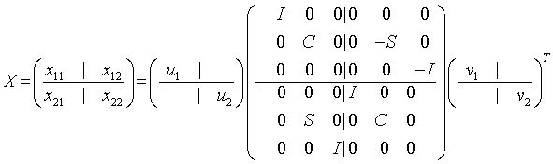
The CS Decomposition
n dimensional subspace of
X=first coordinate dimensions
Y=last coordinate dimensions
Notes:
How many rectangles can you make
Out of two rectangles in the picture
Above? -- there are four note when hypotenuse is on the right and when on the left
Also note the complementary gsvd’s -- what is shared and what it not
Shows where the gsvd is in the cs ---
And also where is the cs in the gsvd ( we need to qr the H and construct the complementary space)

Slide 55
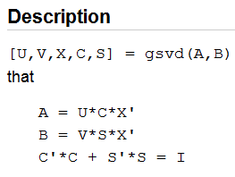
GSVD Formulation (non-orthogonal)
e=gsvd(A,B)

Slide 56
GSVD(A,B)
m=m₁+m₂ dimensions
n ≤ m
A,B have n columns
Flattened View Expanded View
subspaces represented by
lines planes
(m₂ dim)
c₁u₁
Y
( )
s₁v₁
n-dim subspace =span( )
s₁v₁
A
B
c₁u₁
( )
s₁v₁
π
Y
π
s₁v₁
c₁u₁
X
(m₁ dim)
c₁u₁
X
Ex 1: Random line in R² through 0:
On the x axis: c
On the y axis: s
Ex 2: Random plane in R⁴ through 0:
On xy plane: c1,c2
On zw plane: s1,s2

Slide 57
GSVD(A,B)
m=m₁+m₂ dimensions
n ≤ m
A,B have n columns
Flattened View Expanded View
subspaces represented by
lines planes
(m₂ dim)
c₁u₁
Y
( )
s₁v₁
n-dim subspace =span( )
s₁v₁
A
B
c₁u₁
( )
s₁v₁
π
Y
π
s₁v₁
c₁u₁
X
(m₁ dim)
c₁u₁
X
Ex 3: Random line in R³ through 0:
On the xy plane: c and 0
On the z axis: s
Ex 4:
Random plane in R³ through 0:
On the xy plane: c and 1 (one axis in the xy plane)
On the z axis: s

Slide 58
GSVD Jacobian
The Players

Slide 59
GSVD Jacobian
The Players
The Differential

Slide 60
GSVD Jacobian
The Differential
Diagonal
Anti-symmetric
Rectangle
Rectangle
Notes:
\color[rgb]{0.098039,0.160784,0.317647}
\color[rgb]{0.000000,0.458647,0.000000}(U^{\perp})^{T}\rmd UC
\color[rgb]{1.000000,0.740823,0.000000}(V^{\perp})^{T}\rmd VS

Slide 61
GSVD Jacobian
Diagonal
Diagonal
Anti-symmetric
Rectangle
Rectangle
Notes:
\color[rgb]{0.098039,0.160784,0.317647}
\color[rgb]{0.000000,0.458647,0.000000}(U^{\perp})^{T}\rmd UC
\color[rgb]{1.000000,0.740823,0.000000}(V^{\perp})^{T}\rmd VS

Slide 62
GSVD Jacobian
Anti-symmetric (Only for )
Diagonal
Anti-symmetric
Rectangle
Rectangle
Notes:
\color[rgb]{0.098039,0.160784,0.317647}
\color[rgb]{0.000000,0.458647,0.000000}(U^{\perp})^{T}\rmd UC
\color[rgb]{1.000000,0.740823,0.000000}(V^{\perp})^{T}\rmd VS

Slide 63
GSVD Jacobian
Rectangle
Diagonal
Anti-symmetric
Rectangle
Rectangle
Notes:
\color[rgb]{0.098039,0.160784,0.317647}
\color[rgb]{0.000000,0.458647,0.000000}(U^{\perp})^{T}\rmd UC
\color[rgb]{1.000000,0.740823,0.000000}(V^{\perp})^{T}\rmd VS

Slide 64
GSVD Jacobian
Rectangle
Diagonal
Anti-symmetric
Rectangle
Rectangle
Notes:
\color[rgb]{0.098039,0.160784,0.317647}
\color[rgb]{0.000000,0.458647,0.000000}(U^{\perp})^{T}\rmd UC
\color[rgb]{1.000000,0.740823,0.000000}(V^{\perp})^{T}\rmd VS

Slide 65
GSVD Jacobian
Diagonal
Anti-symmetric
Rectangle
Rectangle
Notes:
\color[rgb]{0.098039,0.160784,0.317647}
\color[rgb]{0.000000,0.458647,0.000000}(U^{\perp})^{T}\rmd UC
\color[rgb]{1.000000,0.740823,0.000000}(V^{\perp})^{T}\rmd VS

Slide 66
What’s left
Integration Over the Stiefel Manifolds
A change of variable gives the eigenvalue density in MANOVA format

Slide 67
Ghost Geometry

Slide 68
Ghost Laguerre and Ghost Jacobi

Slide 69
Given a set of principal angles from the references hyperplane , what’s the volume of the -dim subspaces in that are at that set of angles?
Notes:
Given a set of principal angles from
the reference hyperplane, how many
(really volume!)
subspaces are at that set of angles?

Slide 70
Given a set of principal angles from the references hyperplane , what’s the volume of the -dim subspaces in that are at that set of angles?
Notes:
Given a set of principal angles from
the reference hyperplane, how many
(really volume!)
subspaces are at that set of angles?

Slide 71
Selberg Integral
Upon variable change gives exactly the constant

Slide 72
Summing it all up
GSVD more natural than MANOVA formulation
One can write Jacobians for Hermite, Laguerre, Jacobi for all beta as if full models exist
The ghost Stiefel and Grassmann volumes are exactly the right constants in the traditional pdf’s
All terms in integrand have a natural ghost interpretation
Selberg Integrals, Jacobians, Differential Geometry all love ghosts

Slide 73
Summing it all up
GSVD more natural than MANOVA formulation
One can write Jacobians for Hermite, Laguerre, Jacobi for all beta as if full models exist
The ghost Stiefel and Grassmann volumes are exactly the right constants in the traditional pdf’s
All terms in integrand have a natural ghost interpretation
Selberg Integrals, Jacobians, Differential Geometry all love ghosts
Beta is
NOT
just
1,2,4 anymore
I believe
in beta

